Slide 1

Click Title
Junior Cycle
Information for Parents
Part 2

Slide 2


Assessment
Reporting
The purpose of assessment at this stage of education is to support learning.
(Framework for Junior Cycle 2015, p. 35)

Slide 3
A changing culture of Assessment
Assessment in support of learning
Assessment focused on offering effective feedback
Greater variety of assessment activity - “fit for purpose” and relevant to students
Teachers talking to teachers about assessment
Building capacity, knowledge and confidence in assessment, in schools

Slide 4
Your child will be involved in
Reviewing feedback and identifying what they have done well
Identifying what to do next
Setting and achieving personal goals
Redrafting and correcting their own work
Giving feedback to others
Considering examples of good work and identifying how they can improve on their own work

Slide 5

Assessment:
Subjects
Short Courses
Level 2 Learning Programmes L2LPs

Slide 6
Assessment: Subjects
Exams will be set, held and marked by the State Examinations Commission in June of third year.
English, Irish and Maths specified at Higher and Ordinary levels
All other subjects specified at a Common Level
Duration of 2 hours or less

Slide 7
One Subject’s Journey
1
2
Check In
3
Check In
Check In
Transition from
Primary School
First Year
Second Year
2^{nd Year}
^{Classroom-Based Assessment}
Third Year
^{3rd Year}
^{Classroom-Based Assessment}
Final
Assessment
Ongoing Assessment
Ongoing Assessment
Ongoing assessment that supports student learning

Slide 8
Classroom-Based Assessment
Classroom-Based Assessments will provide students with opportunities to demonstrate their understanding and skills in a way which would not be possible in a formal examination.
The tasks will cover a broad range of activities including oral presentations, written work of different types, practical or designing and making activities, artistic performances, scientific experiments, projects or other suitable tasks.
A particular purpose of the Classroom- Based Assessments will be to facilitate developmental feedback to students.
Framework for Junior Cycle 2015, p. 37

Slide 9
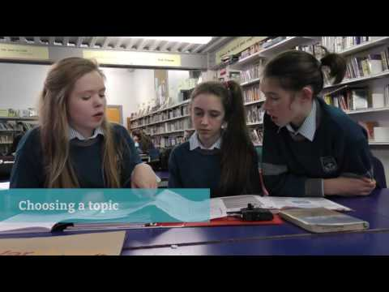
Classroom-Based Assessment Example: English

Slide 10
Assessment Task
The written Assessment Task is marked by the State Examinations Commission
It may require the student to demonstrate an understanding of the knowledge and skills developed during the second Classroom-Based Assessment.
The written Assessment Task may also provide an opportunity for students to refer to skills and competences that were developed and describe ways in which their learning might be applied to new situations.
The Assessment Task will be completed in class under the supervision of the teacher and will be sent to the SEC for marking along with the script for that subject in the state-certified examination.
Framework for Junior Cycle 2015, p. 38

Slide 11
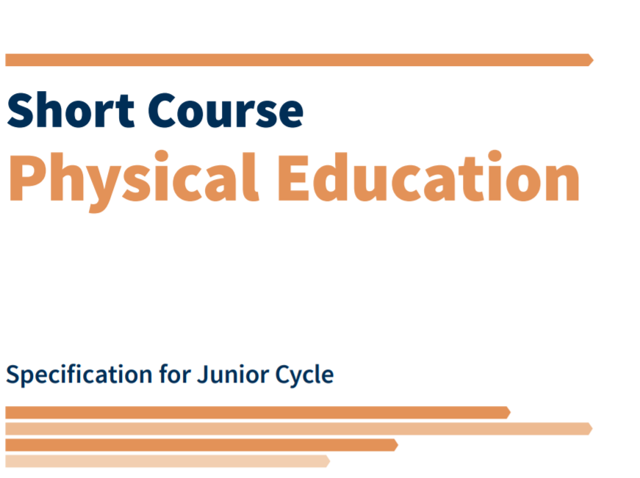

Assessment:
Short Courses
One Classroom-Based Assessment in each Short Course
School reports to parents and students
All assessment in Short Courses is school-based

Slide 12
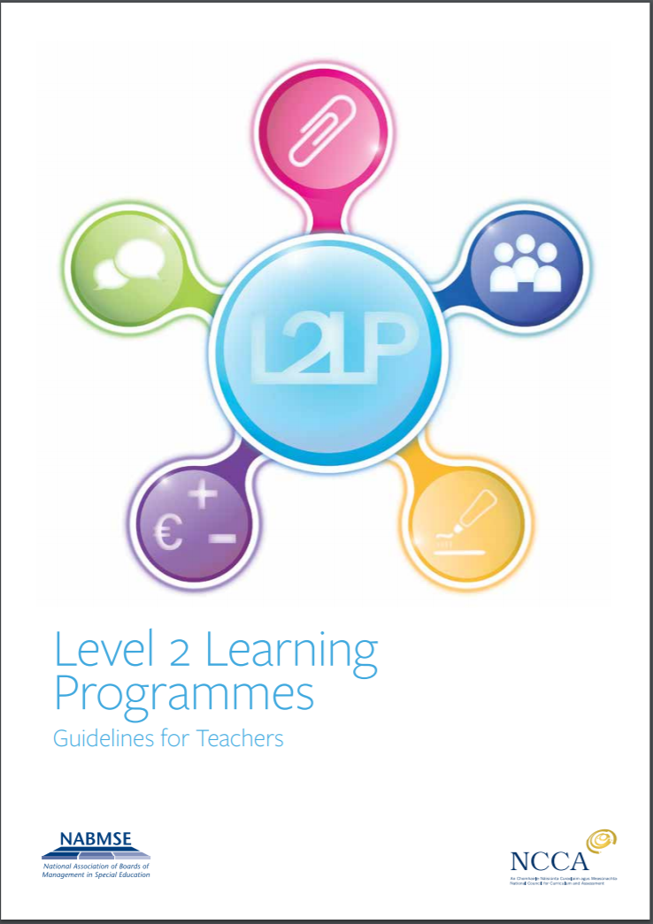
Assessment:
Level 2 Learning Programmes
School based
PLUs are reported as “Achieved” if the Learning Outcomes in the PLU have been achieved
All Priority Learning Units and Short Courses that have been achieved will appear on the JCPA

Slide 13
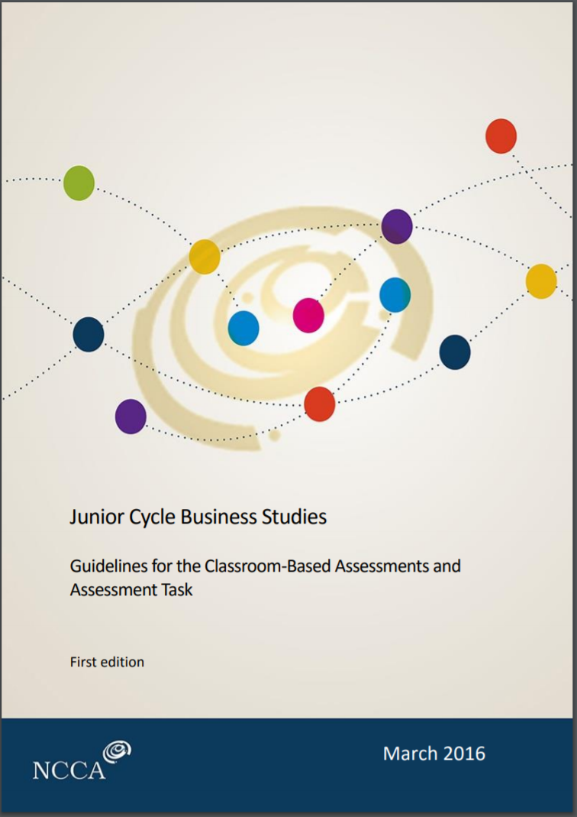
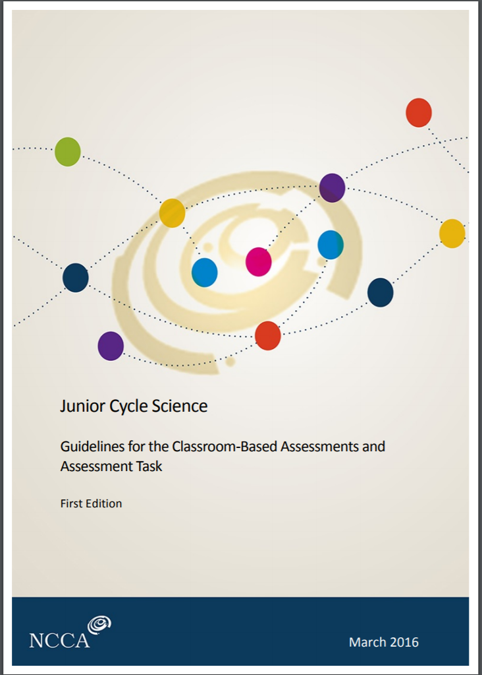
How do Classroom-Based Assessments take place?
Details of the Classroom-Based Assessment are set out in Assessment Guidelines of each Subject and Short Course
Teachers will choose Classroom-Based Assessment tasks as per the subject / short course Assessment Guidelines
The NCCA will provide guidance on assessing these Classroom-Based Assessments
Features of quality are described for each Classroom-Based Assessment

Slide 14
Ensuring Quality
Schools will organise “Subject Learning and Assessment Review” meetings
Teachers will compare their assessment of students’ work and ensure a common approach across the school
CPD will be provided for teachers to ensure that the Classroom-Based Assessments align to a national standard

Slide 15
Reporting
Junior Cycle will build on reporting currently carried out at Primary level
Reporting will happen in first, second and third-year
First-year reporting will focus on student learning and self-development
Second and third-year reporting will include the school-based components that will form part of the Junior Cycle Profile of Achievement
The NCCA will develop guidelines for providing these reports to students and parents

Slide 16
Steps towards the Junior Cycle Profile of Achievement
Classroom-Based Assessments of subjects (and Short Courses if offered) will be completed in second and third-year
Students will sit written SEC prepared examinations in June of third-year for subjects
Assessment in Short Courses is school-based
Schools will report on student engagement and participation in the Other Areas of Learning section of the JCPA over the course of Junior Cycle

Slide 17
The Junior Cycle Profile of Achievement will report on
SEC examinations of subjects
Classroom-Based Assessments
including subjects and short courses
Priority Learning Units PLUs
Other Areas of Learning

Slide 18
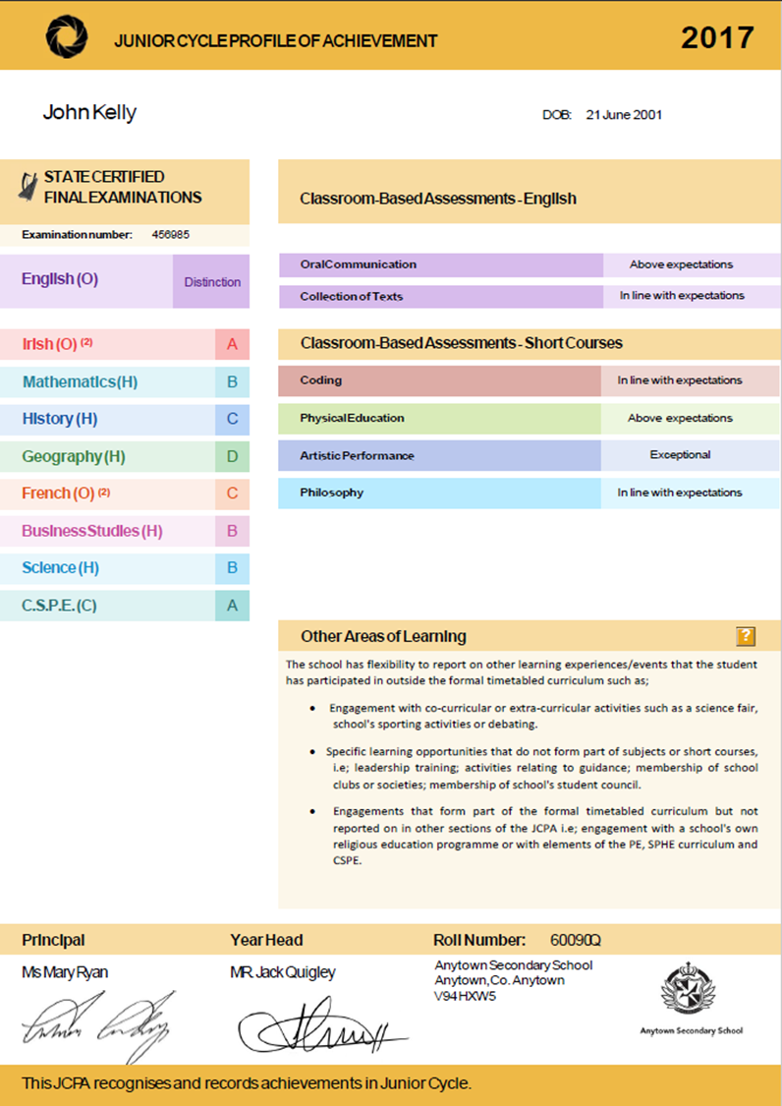
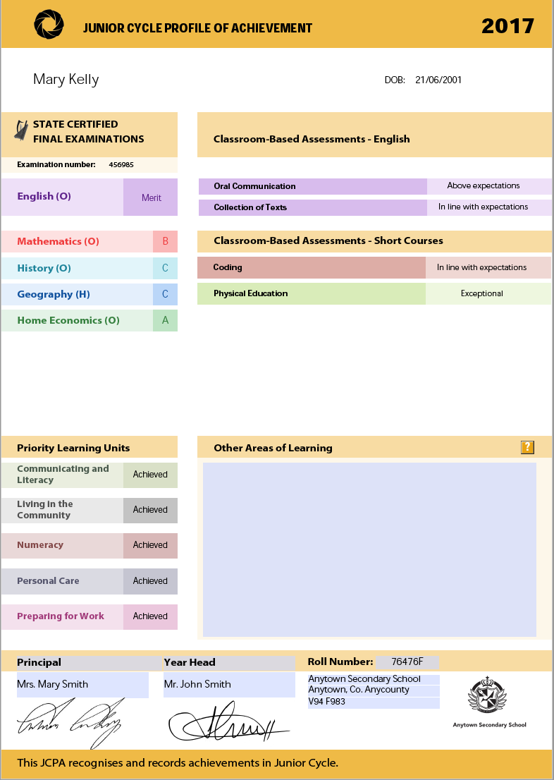

Slide 19
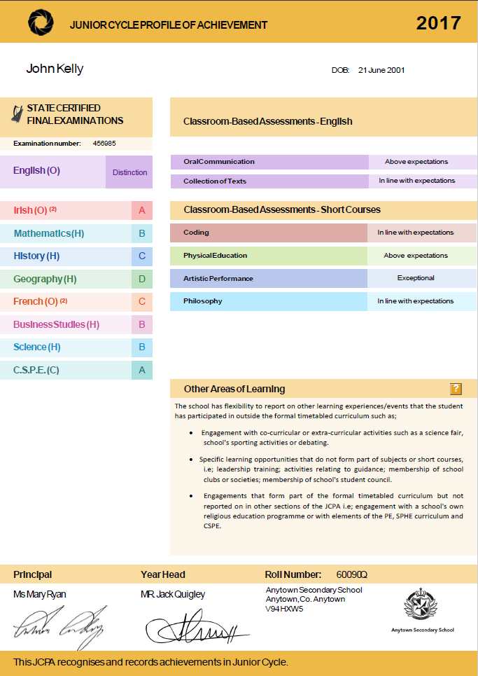
Subjects

Slide 20

State Examinations
Distinction
Higher Merit
Merit
Achieved
Partially Achieved
Not Graded
Classroom-Based Assessments
Exceptional
Above expectations
In line with expectations
Yet to meet expectations
Not reported

Slide 21
Short Courses

Slide 22
Other Areas of Learning

Slide 23
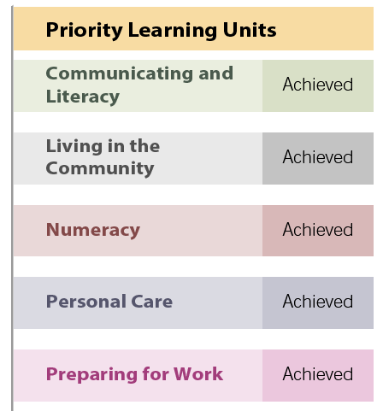
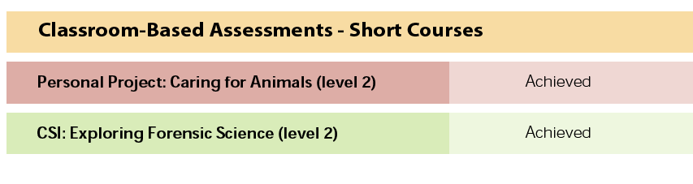
Level 2 Learning Programmes

Slide 24
What is the purpose of education in Junior Cycle?
Help students become better learners and develop a love of learning
Provide a solid foundation for further study
To develop skills for learning and life
To support learning through improved reporting to both students and parents

