Slide 1

Click Title
Junior Cycle
Information for Parents
Part 1

Slide 2
For the Presenter
This slide is hidden
The purpose of this PowerPoint Presentation is to provide schools with a comprehensive number of slides that will support them in informing parents about Junior Cycle reform. It is an overview with the key areas highlighted on Slide 4.
You can download and edit this PowerPoint to suit the context in which you are engaging with parents.

Slide 3
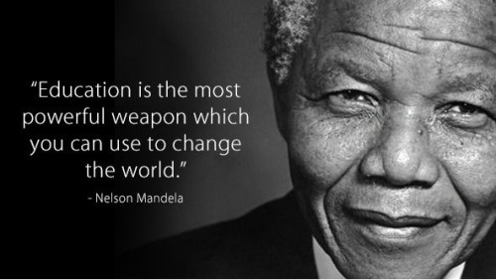

Slide 4

Overview
Our students
2. Structure of the Junior Cycle
3. Subjects, Short Courses, Wellbeing and Other Areas of Learning
4. Assessment and Reporting
5. Junior Cycle Profile of Achievement (JCPA)

Slide 5


Our Students
Auto Animated Version
Connecting primary and secondary
Settling in and making progress in first year
A purposeful second year
Ongoing assessment to support learning
Literacy and numeracy for learning and life

Slide 6
What is the purpose of education in Junior Cycle?
Help students become better learners and develop a love of learning
Provide a solid foundation for further study
To develop skills for learning and life
To support learning through improved reporting to both students and parents

Slide 7

What will students experience in Junior Cycle?

Slide 8
Learning to Learn
Wellbeing
Choice and Flexibility
Inclusive Education
The Principles of Junior Cycle Education
Quality
Continuity and Development
Creativity and Innovation
Engagement and Participation

Slide 9
Structure of the Junior Cycle
Assessment and Reporting
Level 2 Learning Programmes
Subjects
Wellbeing
Short Courses
Other Areas of Learning
C
U
R
R
I
C
U
L
U
M
8 Key Skills
24 Statements of Learning
8 Principles

Slide 10
Your child in First-year
Sept 2016
Sept 2017
Sept 2018
English
Science
Business Studies
Irish
Art, Craft & Design
Modern Languages
Maths
History
Geography
Music
Home Economics
Wellbeing
English
Science
Business Studies
English
Science
Business Studies
Irish
Art, Craft & Design
Modern Languages
Wellbeing

Slide 11
Sept 2019
All subjects from 2018 plus
Materials Technology Wood
Metalwork
Technology
Technical Graphics
Religious Education
Jewish Studies
Classics
Wellbeing
Furthermore:
Other Areas of Learning will also be reported on
Schools can offer the Level 2 Learning Programme
Schools can offer Short Courses

Slide 12
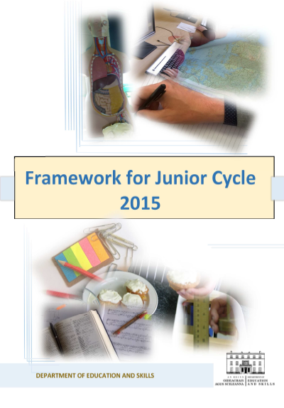
Flexible programme for student learning
Balance between knowledge and skills
Key Messages of
Framework for Junior Cycle 2015
Dual approach to assessment
Reporting a broader picture of learning
Student wellbeing is central to the Framework
Supporting continuity and learning- building on primary school

Slide 13
What stays the same?
Students experience a broad and balanced curriculum
Standards and expectations remain high
Subjects continue to play an important role in the Junior Cycle
The Department of Education and Skills will monitor quality across all schools
The State Examinations Commission will continue to be involved in assessment for certification

Slide 14
What is improving?
A better and a more engaging learning experience for your child
Updated subject specifications
Quality reporting back to parents and students
Assessment to support learning
An emphasis on Key Skills and preparation for life
A sound preparation for learning at Senior Cycle and beyond

Slide 15
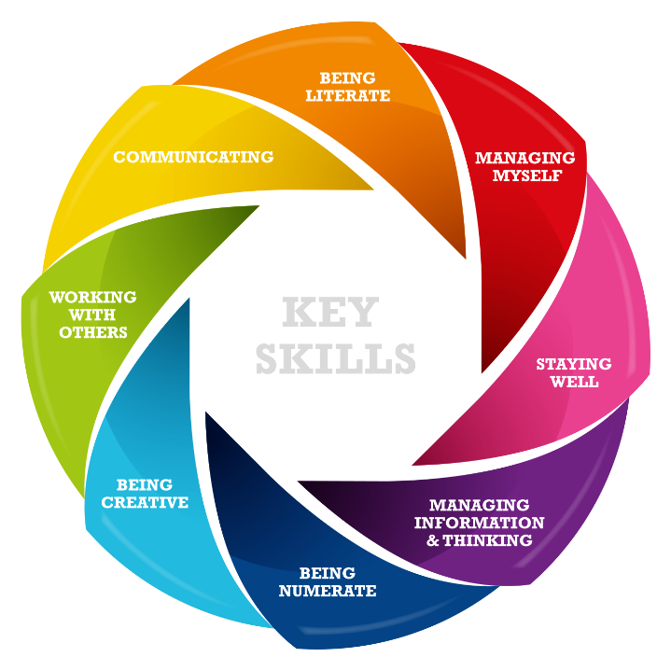

Slide 16
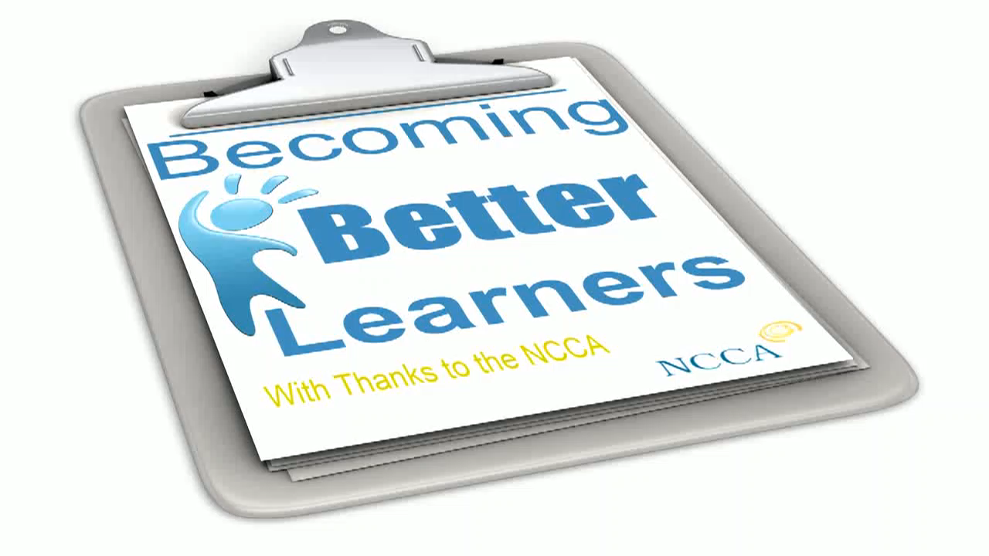

Slide 17
Mathematics
Science
Home Economics
Business Studies
24 Statements
of Learning
Music
Art, Craft and Design
Classics
Religious Education
History
Geography
Jewish Studies
Subjects
English
German
Irish
Spanish
French
Italian
Key Skills
Technical Graphics
Materials Technology Wood
Technology
Metalwork

Slide 18
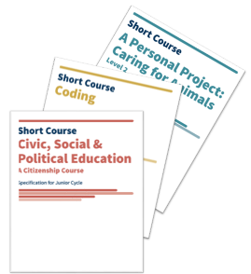
Short Courses
Civic, Social & Political Education
Social Personal Health Education
Physical Education
Level 3
Coding
Philosophy
Digital Media Literacy
Chinese Language and Culture
Artistic Performance
Level 2
A Personal Project: Caring for Animals
Exploring Forensic Science
Enterprise in Animation

Slide 19

Wellbeing
300 & moving to 400 hours over 3 years
Physical Education
Social, Personal and Health Education (including Relationship and Sexuality Education)
Civic, Social and Political Education
Guidance

Slide 20
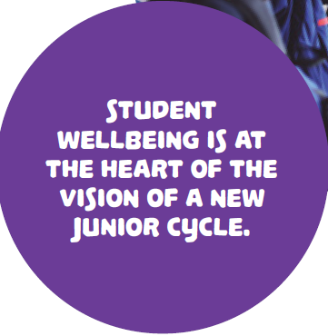

Slide 21

Why does wellbeing matter?
Student wellbeing is present when the students realise their abilities, take care of their physical wellbeing, can cope with the normal stresses of life, and have a sense of purpose and belonging to a wider community.
Junior Cycle Wellbeing Guidelines (2017)

Slide 22
Building a shared understanding of wellbeing
It is important that the whole school community builds and shares a common understanding of wellbeing, especially of what we mean when we talk about student wellbeing
Wellbeing for All
Wellbeing Guidelines p.15

Slide 23
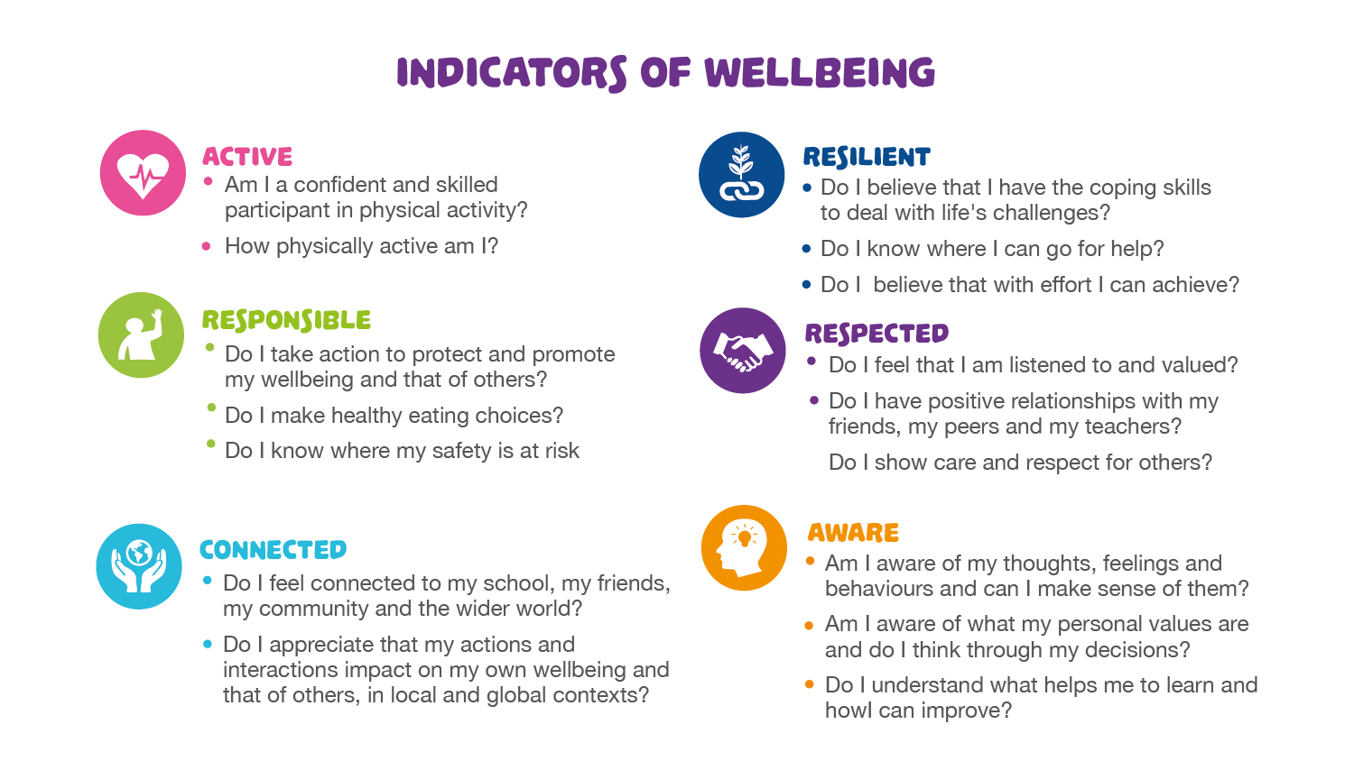

Slide 24

Who are L2LPs designed for?
Learners with a low mild to high moderate learning disability
The special needs of this child is such as to prevent him from accessing some or all of the subjects and short courses on offer at junior cycle.
A Framework for Junior Cycle, 2015

Slide 25
What are Level 2 Learning Programmes?
There are 5 Priority Learning Units (PLUs)
Each PLU focuses on developing the social, personal and pre-vocational skills that prepare students for further study, for work and for life
Communication and Literacy
Numeracy
Personal Care
Living in the Community
Preparing for Work
Plus 2 Short Courses

Slide 26
Spirituality
Ethics
24 Statements
of Learning
Guidance and Counselling
Co-curricular activities
Other Areas of Learning
Pastoral Care
Visiting Speakers
Debating
Citizenship
Student Council
Key Skills
Sports

